Slide 1


Slide 2
1) What is the Purpose/function of the CPU

Slide 3
2) What is the function of the:
MAR –
MDR –
Program Counter –
Accumulator –
ALU –
Control Unit –

Slide 4
3) What happens at each stage of the FETCH-DECODE-EXECUTE cycle?
  Fetch –
  Decode –
  Execute –

Slide 5
4) Name three factors affecting the performance of a CPU.

Slide 6
5) What is an Embedded System? Give one example
Examples:

Slide 7


Slide 8
6) Name three types of device that contain RAM.

Slide 9
7) Why do these devices need RAM?

Slide 10
8) Why is RAM said to be volatile?

Slide 11
9) Name three types of device that contain ROM.

Slide 12
10) Why do these devices need ROM?

Slide 13
11) Why is ROM said to be Non-Volatile?

Slide 14
12) Name three types of Flash Memory.

Slide 15
13) Name three computer devices that use a solid state drive?

Slide 16
14) When might you computer use virtual memory?

Slide 17
15) Where might you find virtual memory?

Slide 18
16) Name one disadvantage of virtual memory?

Slide 19
17) Why do we need to use secondary storage?

Slide 20
18) Name a type of memory that is volatile.

Slide 21
19) Name two types of secondary storage that are non-volatile.

Slide 22
20) Data Capacity
Digital data is stored as ………..
Each 1 or 0 is a …………….. of data.
4 BITS of data is called a ……………..
8 BITS of data is called a ………………….
1000 BYTES is called a …………………….
1000 KILOBYTES is called a ………………………
1000 MEGABYTES is called a …………………………
1000 GIGABYTES is called a …………………………..
1000 TERABYTES is called a ……………………………..

Slide 23
21) Joe wants to save his video files (these have an average size of 400 MB) to an external hard disk drive with a capacity of 1 TB. Approximately how many videos can he store on the external HDD.

Slide 24
22) Aisha has bought a new laptop with a 128 GB SSD. The operating system and other software applications require 48 GB. She wants to use it to store MS Word files that are usually around 100 KB. Approximately how many files can she store on her laptop?

Slide 25
23) What are the advantages of using optical storage?

Slide 26
24) What are the disadvantages of using optical storage?

Slide 27
25) What are the advantages of using Magnetic Storage?

Slide 28
26) What are the disadvantages of using Magnetic Storage?.

Slide 29
27) What are the advantages of using Solid State Storage?

Slide 30
28) What are the disadvantages of using Solid State Storage?

Slide 31
29) Convert the following binary numbers into denary numbers
00011011
10101010

Slide 32
30) Convert the following denary numbers into binary numbers.
130
71

Slide 33
31) Carry out this binary addition
1 0 1 0 1 0 1 1 +
0 0 1 1 1 1 0 0

Slide 34
32) Convert these numbers from binary to hexadecimal
10000001 –
11001110 -
2. Convert these numbers hexadecimal to binary
BA -
7E -
3. Convert these numbers from Denary to Hexadecimal
241 –

Slide 36
33) Calculate The binary number 10001100 right shift by 2

Slide 37
34) What is a character set?

Slide 38
34) What is the difference between ASCII and Unicode?

Slide 39
36) If you typed the English alphabet into notepad and saved the file, how big would the file be in bytes?

Slide 40
37) If D is 01000100 What is E

Slide 41
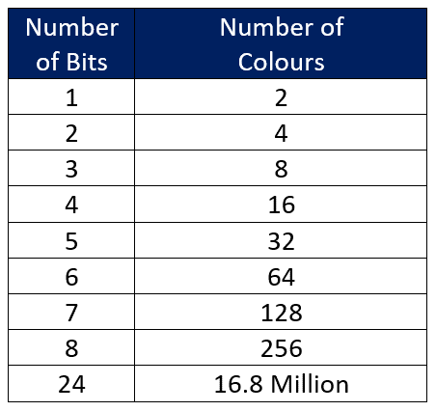
Data Storage: Images
The more bits that you use to represent each pixel the more colours you can use. This is called the colour depth.

Slide 42
38) How many colours can you make if you use 9 bits per pixel?

Slide 43
39) What is the difference between resolution and colour depth?

Slide 44
40) Why are hexadecimals used in photo-editing programs rather than binary ?

Slide 45
Calculating the File Size of an Image File.
There are three factors that determine the file size of an image file.
Colour Depth– The number of bits used to represent each pixel
Image Height– How many pixels high is the image?
Image Width – How many pixels wide is the image?
Colour Depth x Image Height x Image Width

Slide 46
41)What is the file size of an Image with a width of 640 and height of 480 with a colour depth of 24 bits?

Slide 47
42) What is the difference between analogue and digital audio?

Slide 48
43) List three reasons why files need to be compressed.

Slide 49
44) What is the difference between bit depth and sample rate?

Slide 50
45) Which audio has a higher sample rate CDs or Blu rays?

Slide 51
46) What is the file size of an audio file with a bit depth of 16-bits and a sample rate of 44,000 Hz that lasts for 5 minutes?

Slide 52
47) What is file compression?

Slide 53
48) What is the difference between lossless and lossy compression?

Slide 54
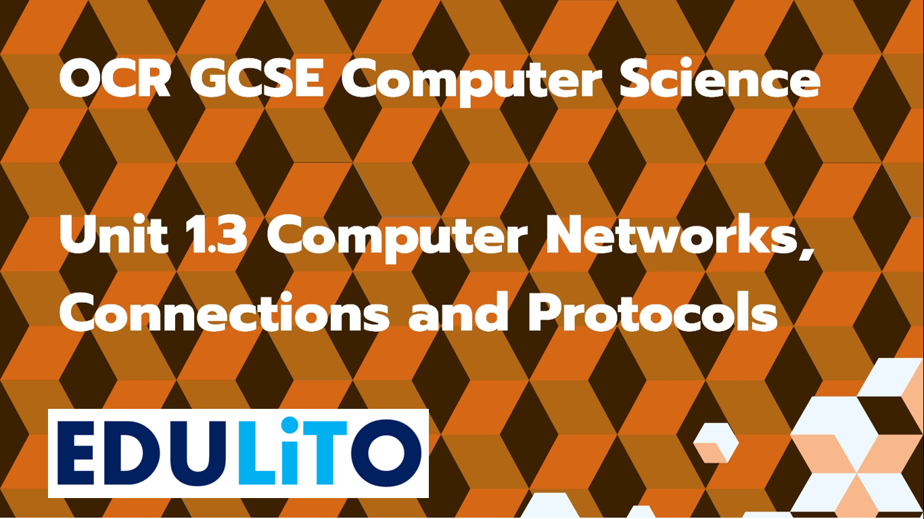

Slide 55
49) Give three examples of LANs

Slide 56
50) Give three examples of WANs

Slide 57
51) Describe the role played by each of the following in a network?
Server –
Switch –
Router –
NIC –

Slide 58
52) What are the two types of cable used in a wired network?

Slide 59
53) What is network Topology?

Slide 60
54) What is a Star Network?

Slide 61
55) Name two advantages of a Star Network.

Slide 62
56) What is a Mesh Network?

Slide 63
57) Name two advantages of a Mesh Network

Slide 65
58) What is a MAC Address?

Slide 66
59) What is an IP Address?

Slide 67
60) What is Ethernet?

Slide 68
61) Give an example of a technology that operates at 2.4GHz or 5GHz?

Slide 69
62) What is the purpose of each protocol?
TCP/IP –
HTTP –
HTTPS –

Slide 70
FTP –
SMTP –
IMAP –
POP –

Slide 71
63) What is the role of each of these layers in sending data across a network?
Application Layer –
Transport Layer –

Slide 72
Network Layer –
Data Link Layer –

